Slide 1
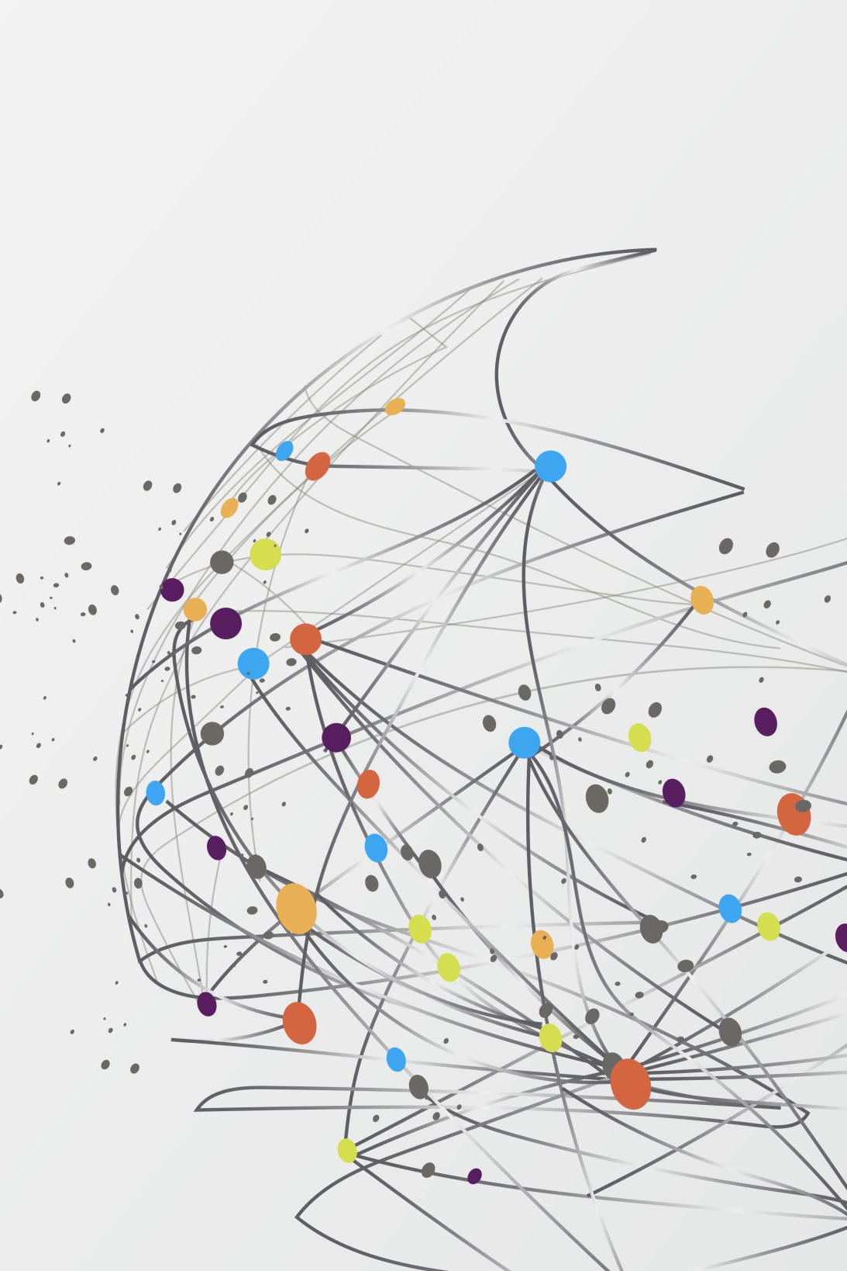

EG2401A
Next Generation Connected Systems and their Technologies
Group 3
Goh Kheng Xi, Jevan A0199806L
Lock Mei Lin A0204751M
Gede Arya A0200704Y

Slide 2
Next-generation Connected Systems
Connected vehicles
Home Security
Health trackers

Slide 3
Connected Vehicles
technologies that connects vehicle to surroundings
communication devices in the vehicle enabling in-car connectivity
and/or enable connection of the vehicle to external devices
autonomous self-driving vehicles & global positioning systems

Slide 4
Ethical Dilemmas unclear liability in the event of accidents
Autonomous/remote driving
A self-driving vehicle by Uber hit and killed a pedestrian.
Car manufacturer or car owner/passenger responsible?

Slide 5
Ethical Dilemmas automotive-related cyberattacks
carjackings, data breaches, taking control of moving vehicles
reliance of vehicles on internet results in hackers having more points of access to breach a car’s systems
trading lower risk of deaths from traffic accidents for new cyber risks such as cyber surveillance

Slide 6
Current solutions
Some major car manufacturers promised they will take responsibility in case any crashes occur
Baidu's automotive cybersecurity lab in China that research vehicle cybersecurity technologies

Slide 7
Solutions
sharing the cost of accidents among all vehicle owners as well as vehicle manufacturers through mandatory insurance
add intrusion detection and or prevention system

Slide 8
Home Security
Monitor movement around the house
Send signals to user smartphone or a central location
Motion sensors, doorbell cameras, etc

Slide 9
Ethical Dilemmas misuse of users’ data
Firms misuse of users’ data
Eg: Ring, owned by Amazon, found to have partnered with local police departments to allow police access data should they require it
Violated rights, virtue and duty ethics

Slide 10
Ethical Dilemmas Illegal Access/Hacking
Illegal access to device or users’ data (i.e. Hacking)
Eg: 2020, StraitsTimes published articles about home security footages begin uploaded to pornographic sites; found to be from hacker group
From firm perspective, duty ethics violated
From hackers’ perspective, rule utilitarianism and right ethics violated.

Slide 11
Ethical Dilemmas Spying
Hidden cameras used in home security, installed in locations such as Airbnb for spying
Global Times published article of an undercover investigation that revealed numerous unsuspecting shots of homes
Violated rights ethics and virtue ethics

Slide 12
Ethical Dilemmas Privacy Intrusion
When home security systems unknowingly intrude into other people’s spaces
Virtue ethics satisfied but duty ethics not satisfied

Slide 13
Current solutions PDPA (Personal Data Protection Act)
Offences include accessing personal data without consent
14 October, ChamptionTutor fined $10 000 for failing to impose appropriate security measures, causing data leak

Slide 14
Solutions Technological solution
Allow for the user to toggle whether to send information to a central authority
Rings -> neighbours app -> allow choices
Rights ethics satisfied

Slide 15
Solutions Firms’ responsibilities
Ensure devices and data are as secured as possible, constantly update security
Inform user of data handling
Allows user to have privacy control
In case of a breach, compensate the victims fairly
Rights, duty and virtue ethics satisfied

Slide 16
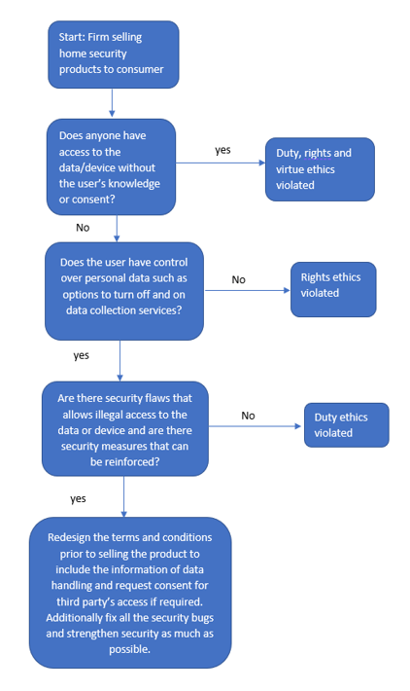
Solutions Ethics decision flow chart

Slide 17
Solutions Societal Responsibilities
Reject malicious behaviours as much as possible
Collectively, not to incentivise hackers
Introduce harsher punishment
Rights ethics satisfied

Slide 18
Solutions Consumers’ responsibilities
Practice good security habits (using strong passwords, enable 2FA, etc)
Report by Verizon in 2019, 80% of data breaches due to hacking were attributed to weak passwords
Consumers also have to work hand in hand with firms to constantly install updates by the firms
Duty ethics satisfied

Slide 19
Health Trackers
Electronic devices that enable users to track and monitor their health
These devices are dependent on users' data
Companies be responsible of the storing of users' data
They could use it for their purposes
Sharing of users' data to other companies (e.g. collaboration purposes)
Analysis of ethical dilemmas using Ethical Line Diagram

Slide 20
Storage and Handling of Users' Data
Companies will have access to users' data
Human Rights alone would not solve all ethical questions
Depends on the context
What type of data is collected from the users? (answered)
Who are involved? => determining the parties
Parties: health-tracker users and data-storing companies
Regulation: Personal Data Protection Act (PDPA)

Slide 21
Ethical Dilemma: Storage of Users' Data
Use Utilitarianism Ethical Theory
Understanding of the benefits for each party
Use Rights Ethics
Human data privacy is closely related to fundamental human rights, in particular rights to privacy
Put Scenarios first => Put into Ethical Line Diagram

Slide 22
Positive Paradigm (PP)
User has given consent for the company to track their data
Health Data only used by the company for health metrics only
Sharing of users' data with external parties would be controlled by written contracts and/or formal declarations
Users be given control over their personal health data (CRUD operations)

Slide 23
Negative Paradigm (NP)
Companies take users' data without consent
Users' health data would be used for the companies' purpose
Data sharing with external parties would not be controlled
Users have limited control/authority over their data

Slide 24
Point 1: "Rise of Employee Health Tracking"
Article regarding the tracking of employee's health using patches attached to their bodies
Innovative, but they can employ unethical policies such as denying promotions to less-fit employees
Generalize to cases where companies gather users' health data and they use it for their gains through policies and management decisions

Slide 25
Point 2: Sharing Data to Third Parties
A paper that disussed the exploitation of wearable health technology
Users' data from fitness apps are transmitted to various third parties, including advertisers
Data is shared for other purposes, such as advertising
Generalize to similar events where data would be shared for other purposes

Slide 26
Possible Scenario 1 (SC1)
Consent is given by the user
Company extract additional data, metadata, and other information
E.g.: Users' location data from Google could be used to identify when the users are outside their homes etc. => Could be taken advantage of
Sell additional data and/or metadata to external parties

Slide 27
Utilitarianism Ethical Theory
Perspective of companies, utilitarianism is satisfied
Companies create something (health tracker/apps) that would benefit the society
Cases for NP, P1, and SC1: data is also used for the company's benefit
Perspective of users, utilitarianism is satisfied
Data gathered are used for the users' benefits to track their health data
Data can be used by the companies also
As long as the health-tracking system works for their benefit

Slide 28
Rights Ethics
Perspective of users: Rights ethics is satisfied
Users have rights to own property
Users have rights to give or not to give consent
Perspective of companies: Only satisfied for PP
In the case of PP, users' data would be used accordingly
Other cases: violates UDHR Article 12: "No one shall be subjected to arbitrary interference with his privacy"

Slide 29
Rights Ethics for NP, P1, P2, and SC1
NP has worst privacy violation
P2 has arguably worse privacy violation than P1
Data is shared with more and more malicious parties
Greater chance for misuse (by other parties), although the company does not do any malicious attempts against the users' data
SC1 is a combination of P1 and P2 => worse standing than both
At least user gives consent to their data, unlike NP

Slide 30
Scenario | Ethics Line Drawing | Location
PP | Asking for users’ consent, health data used just for health-tracking purposes, valid written documents for health and location data sharing to external parties, users’ have full control over their health data. | Right Point
NP | No user consent, data collected also used by companies for their own benefit, selling or sharing of users’ personal data to external parties, users’ have limited control over their data. | Left Point
P1 | Asking for users’ consent, but users’ health data is also used by the company for their personal gains. | Approx. 6.5/10
P2 | Users’ health data would be sold and/or given to external parties and the data would be used for other purposes. | Approx. 4.5/10
SC1 | Users would give consent, but users’ health data and metadata would be used by the companies and also would be shared with external parties unnoticed. | Approx. 2/10

Slide 31
Solution
Data Protection Laws (PDPA)
Research shows that data privacy rules of companies are ambiguous in their definitions.
There could be gaps where they extract extra information from the user
Example from article: Fitbit and Jawbone
Data privacy laws alone could not stop all cases of data privacy violations

Slide 32
Solution: Self Awareness
Privacy Paradox: cynicism and apathy towards online privacy
Privacy-protective behaviors would lead users to believe that their data would eventually be shared across the internet world
Inevitability of privacy violations
Users should be wary regarding the data they have consented to give through health-tracking devices

